Slide 1
Design Patterns Used
Strategy, Factory Pattern, Template Method, Abstract Factory

Slide 2

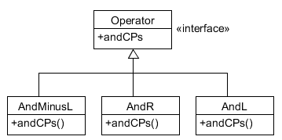



Strategy Pattern

Slide 3
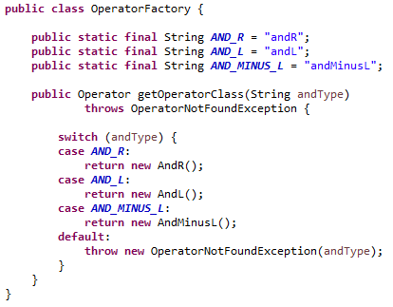
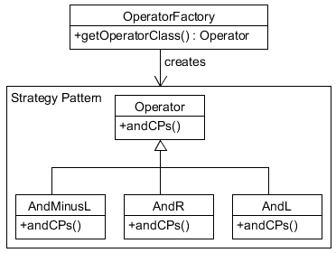
Factory Pattern

Slide 4
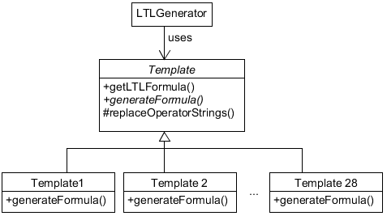
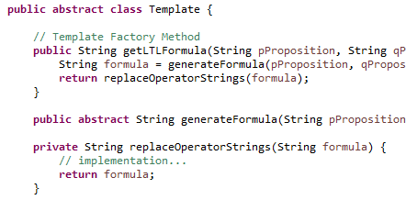


Template Method Pattern

Slide 5
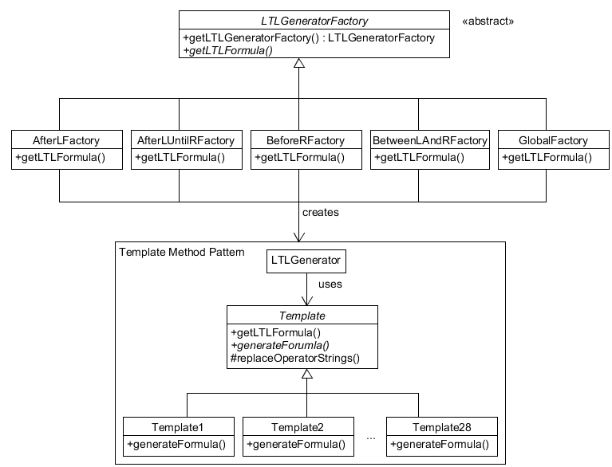
Abstract Factory Pattern

Slide 6
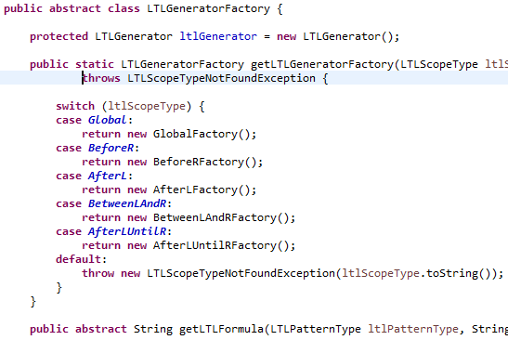
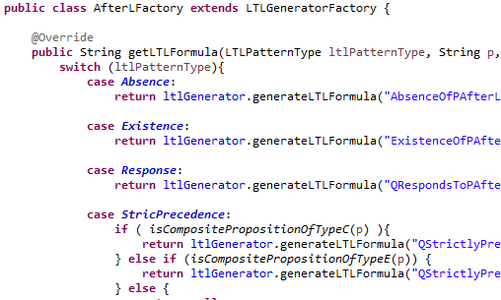
Abstract Factory Pattern

